Slide 1

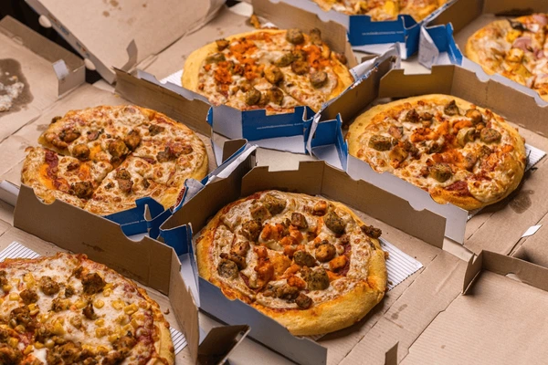
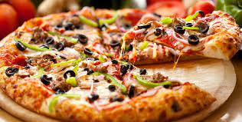
PIZZA SALES
SQL PROJECT​

Slide 2
At PIZZA SALES, we need to examine the dataset with SQL and help the PIZZA SALES Store to understand its business growth by answering few questions below
OVERVIEW

Slide 3

QUESTION NO. 1
WHAT IS THE TOTAL REVENUE OF PIZZA SALES?

Slide 4
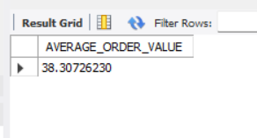
QUESTION NO. 2
What is AVERAGE ORDER VALUE OF PIZZA SALES?

Slide 5
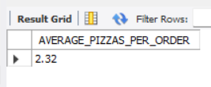
QUESTION NO. 3
WHAT IS AVERAGE PIZZA PER ORDER OF PIZZA SALES?

Slide 6
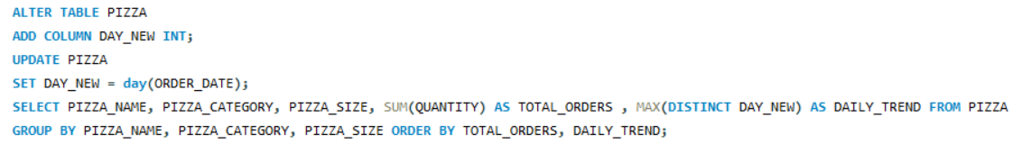
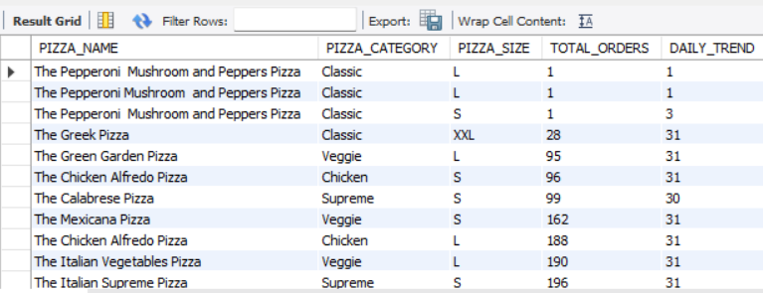
QUESTION NO. 4
WHAT IS DAILY TREND FOR TOTAL ORDER OF PIZZA SALES?

Slide 7
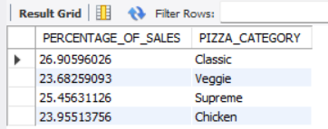
QUESTION NO. 5
WHAT IS PERCENTAGE OF SALES BY PIZZA CATEGORY?

Slide 8
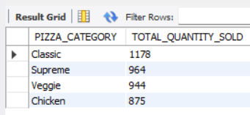
QUESTION NO. 6
WHAT ARE TOTAL PIZZAS SOLD BY PIZZA CATEGORY?

Slide 9
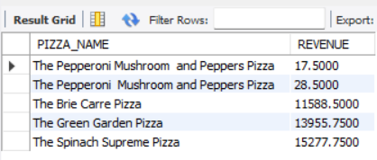
QUESTION NO. 7
WHAT ARE THE TOP 5 PIZZAS BY REVENUE?

Slide 10
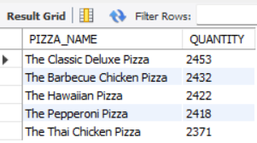
QUESTION NO. 8
WHAT ARE TOP 5 PIZZAS BY QUANTITY?

Slide 11
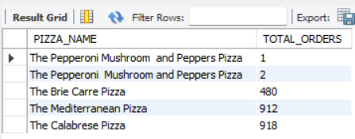
QUESTION NO. 9
WHAT ARE BOTTOM 5 PIZZAS BY TOTAL ORDERS?

Slide 12
At last I’ll summarize the key insights and give data-driven recommendations that can potentially increase the store’s revenue​
SUMMARY

Slide 13
THANK YOU
JAIMIN SHAH​

